Slide 1
Scam Labeler
CS 5342: Trust and Safety: Platforms, Policies, Products
Kk2239, yj586, hg493, hx329

Slide 2
Contents
1.
Motivation
2.
Summary of Approach
3.
Test Design
4.
Demo
5.
Test Results
6.
Next Steps

Slide 3
Motivation
Harm & The Decentralized Gap
CS 5342: Trust and Safety: Platforms, Policies, Products
Tangible Harm
Financial Loss: Phishing attacks use "urgency cues" to steal funds.
Impersonation: Users mistake custom domains for verification.
Trust Erosion: Scams degrade the community experience, hindering adoption.
Vulnerability Gap
Decentralized platforms face a "Cold Start" in safety tools.
Reactive blacklists fail against zero-day phishing domains.
Goal: Mitigate harm via proactive behavioral analysis.

Slide 4
Iteration: Pivots & Hurdles
Refined Policy
Initial Approach
The Pivot
Racism & Hate Speech Labeler
Hurdle: Redundant. Bluesky's core team already has robust, effective moderation for hate speech.
URL Scam Pivot
Insight: Malicious URLs are hard to filter at the protocol level without risking over-censorship.
Heuristic Scoring
Solution: Moved from binary blocking to a "Scam Score" (Profile + Content) to reduce false positives.

Slide 5
Proposed Policy/Approach
Labeling over Removal
Informational Labeling
Behavioral Definition
Proactive
Defense
Community Preservation
We do not remove content. We apply a "Potential URL Scam" label to contextualize risk, empowering users to make their own decisions.
A "scam" is defined not just by a link, but by the convergence of bot-like metrics (ratios) and high-pressure semantic cues.
We target the behavior of the scammer (mass following, hashtag flooding) rather than waiting for a domain to be blacklisted.
By using opt-in labelers, we preserve the open nature of the AT Protocol while protecting vulnerable users.

Slide 6
Testing & Evaluation Strategy
1. Synthetic Data Pipeline
synthetic_posts.json
{ "SYNTHETIC_SCAM_01": { "text": "GUARANTEED RETURNS! bit.ly/scam", "profile": { "followers": 2, "following": 5000, "posts": 150 } }, "SYNTHETIC_SAFE_01": { "text": "Check out my new blog post", "profile": { "followers": 500, "following": 200, "posts": 1200 } } }
Developed synthetic_posts.json to simulate edge cases (e.g., bot profiles with safe links, human profiles with risky links).
Used unittest.mock to simulate API responses for profile metrics without spamming the live network.
2. Real-World Validation
Tested against the live "Firesky" feed to identify false positives.
Outcome: Tuned the cumulative risk threshold to 5 points to balance sensitivity and precision.

Slide 7
Technical Approach
How we’ll address these potential scams
Multisignal Detection
Instead of relying on a single indicator, our system combines profile heuristics, language cues, emoji/hashtag patterns, and URL analysis. This reduces false positives and false negatives because scam posts often exhibit multiple weak signals rather than one strong one.
Robustness to Evasion Tactics
Because multiple independent checks are used, like profile behavior, URLs, text content, an attacker must evade many different types of detection at once, making the system harder to game.
Lightweight and Fast
The checks are computationally inexpensive, string matching, ratio calculations, and CSV lookups—making the system easy to run in real time without ML infrastructure or model latency.

Slide 8
Technical Approach
Goal
Step 1
Step 2
Step 3
Step 4
Checks for potential scams
Checks for high use of emojis
Checks for suspicious language
Checks for commonly used urls to scam sites
A scam score is output, if the score is higher than 5, then the post is flagged as a potential scam

Slide 9
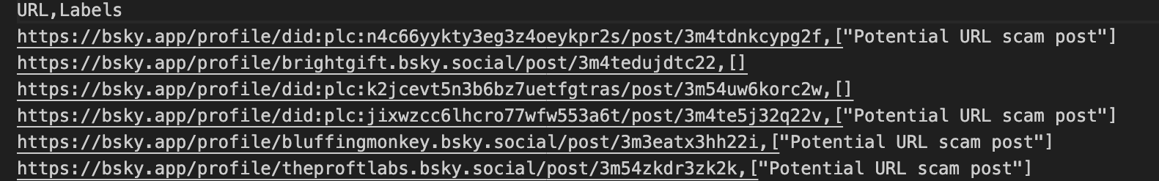
Test Design
Test Set : 154 manually annotated posts (34 real Bluesky posts and 120 synthetic posts)
Approach :
We compared the system's output with human-labeled text one by one, and used the naturalness of real posts and the controllability of synthetic posts to test the model's performance under different conditions.
Why This Is Appropriate :
Combines authenticity (real posts) with completeness (synthetic coverage)
Allows testing both common scenarios and low-frequency but critical threats
Produces a meaningful stress test(154) to evaluate robustness and real-world reliability

Slide 10
Demo

Slide 11

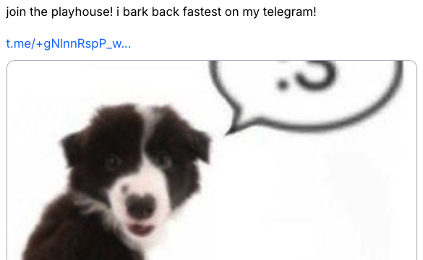
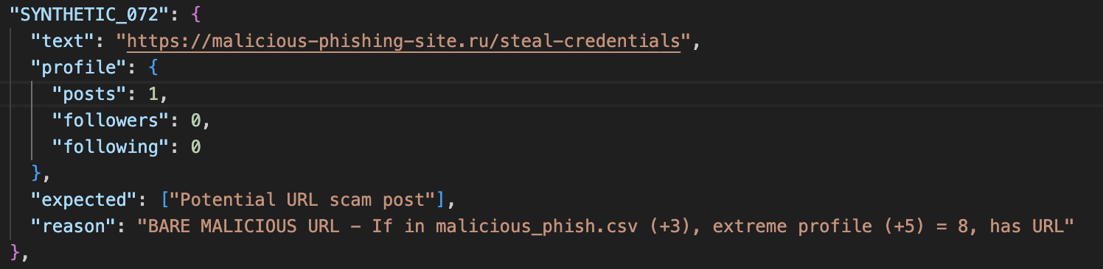
Test Results
Travel-style scam ad
Telegram sexual scam
Unlisted phishing URL
151 / 154 correct classifications （Accuracy: 0.98）
Efficient multi-signal detection, but limited by cleverly disguised or metaphorical scam content
Why was the judgment incorrect?
Why was the judgment wrong?
Used polished, promotional-style wording that appeared harmless, so none of the suspicious-language or urgency-cue rules were activated
Why was the judgment incorrect?
The phishing domain was not present in the malicious_phish.csv blacklist, causing the URL check to assign no risk score,
“dog / bark / playhouse” phrasing bypassed semantic rules
Broader posting-style and behavioral analysis + dynamic URL database

Slide 12
Ethical Implications of Deploying the Policy Labeler
Risk of False Positives
Users who use slang, jokes, or non-standard writing may be unfairly flagged as scams, affecting trust and reputation.
Risk of False Negatives
Well-packaged, metaphorical, or ad-like scam content may escape detection, giving users a false sense of safety.
Privacy and Over-Profiling Concerns
Even when using only basic account information, we must avoid over-profiling users or making inferences they did not consent to.

Slide 13
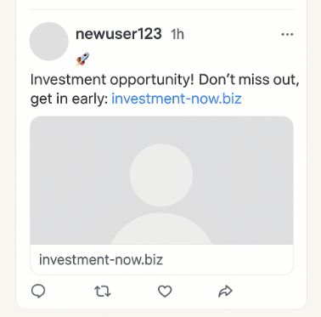
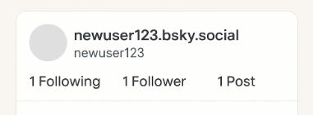
Next steps
Addition #1
Account-Age Checker
Improve detection robustness by incorporating account-age and account-freshness features, catching scams from new accounts that hide behind normal-looking follower/following ratios and post counts.

Slide 14
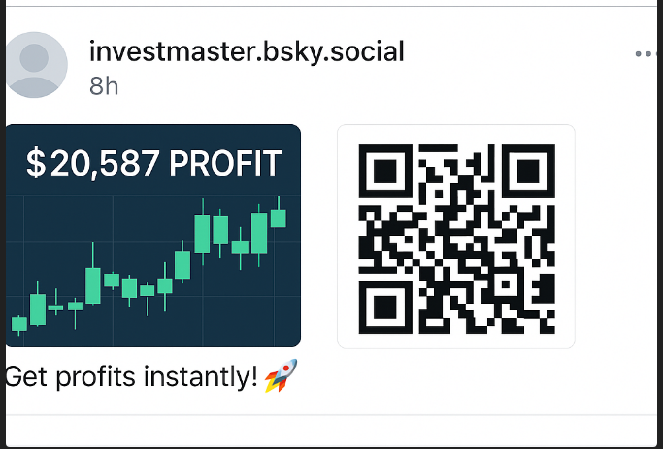

Next steps
Addition #2
Image-Based Scam Detection
Extend beyond text-only analysis by introducing image analysis to detect fake profit screenshots, malicious QR codes, embedded text, and AI-generated/deep fake content that bypasses our current text-based model.

Slide 15
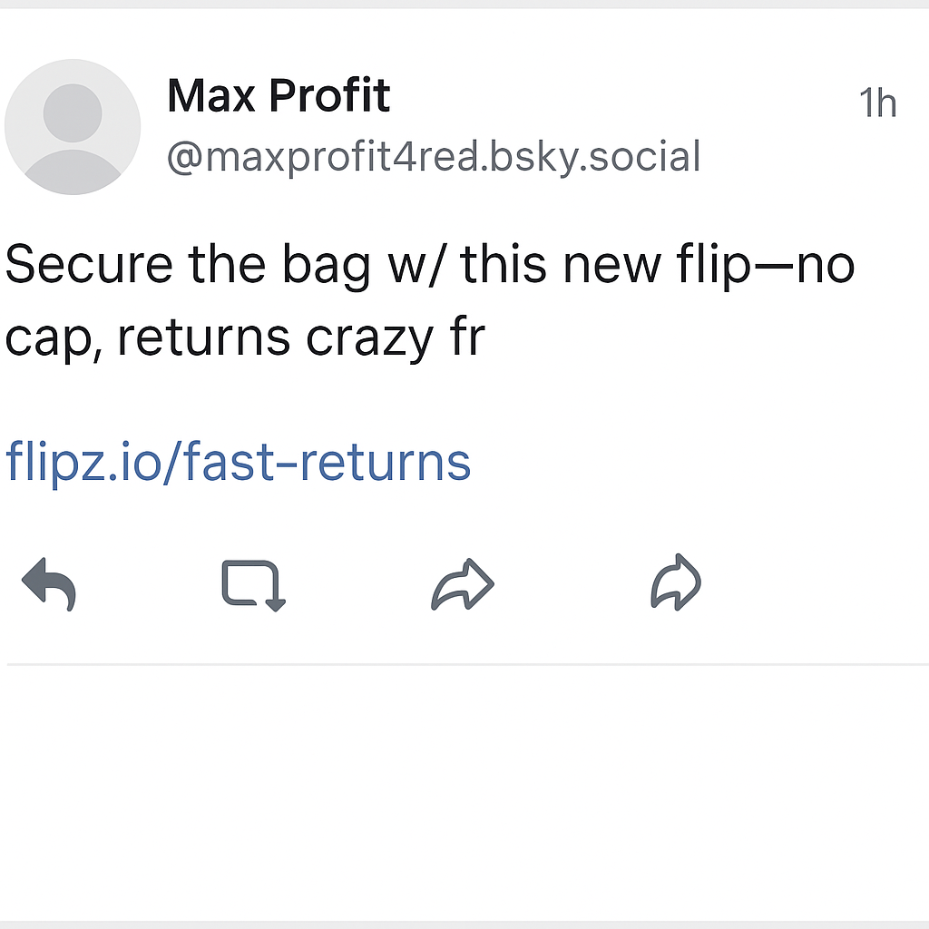
Next steps
Addition #3
Build a Dynamic, Evolving Scam-Phrase Model
Develop an LLM-style adaptive phrase database that continuously learns new scam patterns, detects linguistic variations (“secure the bag” vs. “make money fast”), and captures multilingual and culturally-specific fraud tactics.

Slide 16
Thank you

